Slide 1
Customer Support Automation of Ticket Creation (RPA)
PIP104 University Project-II
VIVA-VOCE
Batch Number: ISR-G09
Roll Number | Student Name
20211ISR0089 | G SUPRITHA
20211ISR0004 | SAMBAVI B
20211ISR0074 | VAISHNAVI
20211ISR0092 | LEKHANA M
Under the Supervision of,
Ms. Deepthi S
Assistant Professor
School of Computer Science & Engineering
Presidency University

Slide 2
Introduction
To enhance efficiency and accuracy in customer support operations, we propose the implementation of an automated ticket creation and management system. This system will streamline the process of creating tickets from incoming complaint emails, reducing manual intervention and ensuring timely responses. By automatically extracting relevant information, validating data, and linking subsequent responses, the system will minimize errors and improve overall customer satisfaction. Additionally, it will automate responses to template-based emails, saving time for support agents and providing consistent customer experiences. The system will leverage multiple bots and parallel processing to handle a high volume of emails efficiently, further reducing response times. Overall, this automated solution aims to transform customer support operations, making them more efficient, accurate, and responsive.

Slide 3
Literature Review
Automating repetitive tasks: RPA streamlines complaint management, ticket creation, and follow-ups, reducing human intervention and improving efficiency.
Data extraction and email parsing: UiPath extracts structured and unstructured data from emails using machine learning and NLP, enhancing data accuracy.
Handling incomplete data: Automated follow-up emails address missing information, improving response times and customer satisfaction.
Cost reduction: Automation lowers operational costs by minimizing manual data entry and repetitive tasks, enabling resource reallocation.
Scalability and flexibility: UiPath adapts to changing needs and integrates with existing ticketing systems (e.g., Zendesk, ServiceNow).

Slide 4
RESEARCH GAPS IDENTIFIED
Managing Contextual Ambiguities in Complaint Data Gap: When emails contain contextual ambiguity, particularly when the complaints are indirect or only partially complete, current systems usually fall short. NLP models that are better at contextual understanding, like Devlin et al. (2018)'s BERT, might not be able to capture the subtleties of the domain or implicit customer needs.
Automated Systems' Scalability for High-Volume Data Gap: Many systems are only workable for small data sets; they cannot grow to handle thousands of real-time complaints. Therefore, a company that handles a lot of customer interactions every day will be hesitant to use them
Addressing Incomplete Complaint Data Effectively Gap: Automated email responses for incompleteness data are already in place, but they typically don't ensure high response rates or resolve ambiguity. Systems such as those developed by Shum et al. (2018) react with generations, but they do not have the means to verify that the follow-up data is comprehensive.

Slide 5
PROPOSED METHODOLOGY
Eliminate manual intervention in ticket creation
1. Raise a ticket based on the complaint mail
2. If the details are incomplete(e.g. customer name is missing), send a mail to
customer asking for missing details.
3. Link the sub sequent responses from the customer to the original ticket
4. Store details in Excel sheet.
5. Extract value from excel and Create ticket in Zoho Desk.

Slide 6
Objectives
Develop an automated system capable of accurately extracting relevant information from incoming complaint emails.
Implement a validation mechanism to identify and address incomplete or missing information in complaint emails, automatically sending follow-up requests to customers for missing details.
Create a system that can effectively link subsequent responses from customers to the original ticket, ensuring a unified conversation thread and facilitating efficient resolution.
Develop a robust mechanism to identify and handle bounced emails, initiating appropriate actions such as resending the email or updating the customer's contact information.
Explore the use of multiple bots or parallel processing to handle a high volume of incoming emails efficiently and reduce response times.

Slide 7
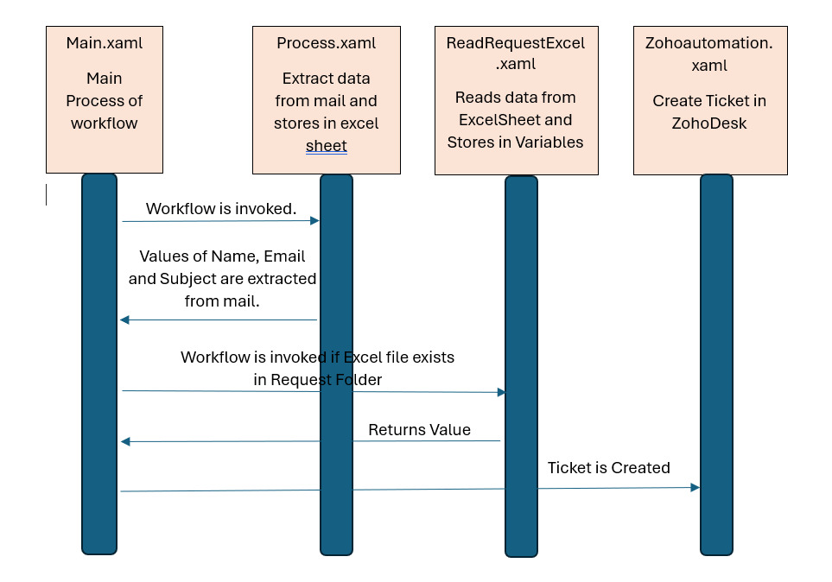
SYSTEM DESIGN AND IMPLEMENTATION

Slide 8
TIMELINE OF THE PROJECT
PHASE | TASK | DURATION
Project Initiation | Define project scope and objectives | 2/9/2024 – 15/9/2024
Process Analysis | Document current customer support processes | 16/9/2024 – 28/9/2024
Technology Selection | Research and evaluate RPA tools | 29/9/2024 – 5/10/2024
Development | Develop RPA workflows and bots | 6/10/2024 – 20/11/2024
Deployment | Integrate RPA bots into existing systems | 21/10/2024 – 15/12/2024
Research Paper | Collecting and writing Research paper | Parallel to project

Slide 9
OUUTCOME/RESULT OBTAINED
Increased Efficiency: Automated data extraction eliminates manual entry and human error, speeding up ticket generation. Automated follow-ups for incomplete information improve data quality and reduce workload on support staff.
Improved Accuracy: Automated data extraction minimizes errors in ticket creation. Automated follow-ups ensure complete and accurate information is captured.
Enhanced Customer Satisfaction: Faster ticket generation and response times improve customer satisfaction. Consistent communication and a comprehensive view of customer issues facilitate faster resolutions.
Reduced Operational Costs: Automation reduces the need for manual labor, leading to cost savings. Improved efficiency and reduced errors minimize the time and resources spent on resolving issues.

Slide 10
Conclusion
By using UiPath RPA to automate ticket creation drastically improves efficiency and customer service. The system automates email processing, reducing manual work, errors, and speeding up response times. Automated follow-ups ensure data completeness, and unique identifiers and templates maintain consistent communication. Multiple bots working in parallel enhance scalability for increased workloads. This methodology not only solves current challenges but also sets a strong foundation for future growth, boosting both efficiency and customer satisfaction.

Slide 11
References
Mullakara, N., & Asokan, A. K. (2020). Robotic process automation projects: build real-world RPA solutions using UiPath and automation anywhere. Packt Publishing Ltd.
Sindhuja, R., Modugu, P. T., Goud, S. A., Kumar, E. R., Babu, G. S., & Reddy, R. (2024, June). A Comparitive Analysis of RPA tools: UiPath, Automation Anywhere and Robocorp. In 2024 OPJU International Technology Conference (OTCON) on Smart Computing for Innovation and Advancement in Industry 4.0 (pp. 1-6). IEEE.
Khan, S. P., & Khan, R. (2023). RPA Using UiPATH in the Context of Next Generation Automation. Robotic Process Automation, 395-422.
Potturu, S. M. (2023). Seamless Automation: Integrating UiPath Bots into Organizational Systems and Workflows Using the Start Jobs API. J Robot Auto Res, 4(3), 412-423.
Nalini, M., Dhanraj, R. K., Balusamy, B., Abirami, V., Kavya, K., & Aishwaryalakshmi, G. (2024). Bot‐Based Process Triggering by Incoming E‐mails and Documents. Hyperautomation for Next‐Generation Industries, 177-205.

Slide 12
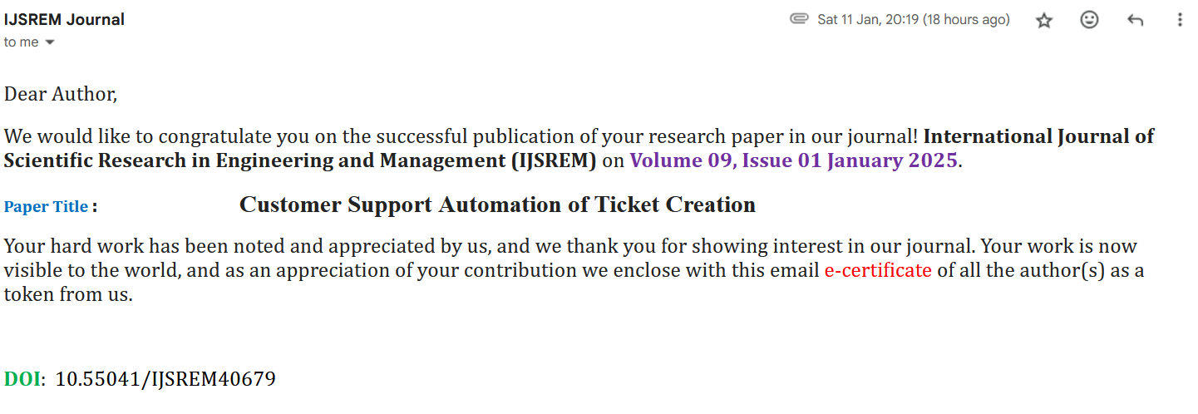
PUBLICATION DETAILS

Slide 13
ACHIEVEMENTS (IF ANY)

Slide 14
Thank You

